Slide 1
CS4101 Introduction to Embedded Systems Lab 3: Interrupt
Prof. Chung-Ta King
Department of Computer Science
National Tsing Hua University, Taiwan

Slide 2
Introduction
In lab 2, we have learned how to precisely set the time of a system, e.g. flash frequency of the LEDs, duration of button down, etc.
However, CPU still wastes time polling registers in I/O modules to detect events, e.g. Timer0_A3 time up, button down, etc.
In this lab, we will learn how to let I/O modules notify CPU when events occur through interrupts, so that CPU is free to do other things until events occur

Slide 3
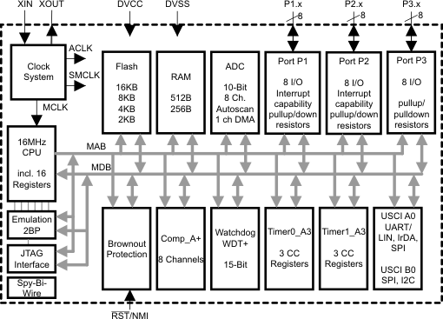
Interior of MSP430G2553
Lab 1
Clock system
GPIO
X
Not available on 20-pin device
Lab 2
Timer system

Slide 4
Lab 3
Basic 1: Use interrupt to handle events (40%)
Modify Basic 2 of Lab 2 so that
When the button is released, the green LED is on for 0.7 sec first and then the red LED is on for 0.3 sec alternatively.
flash pattern 1
When the button is pressed, turn both LEDs on for 0.7 sec first and off for 0.3 sec repetitively
flash pattern 2
Control the time from Timer0_A3 driven by ACLK sourced from VLO running at 12KHz.
When switching patterns, LEDs should start with initial state.
Handle all events by interrupts, so you should not write any code in the loop of main().

Slide 5
Lab 3
Basic 2: Measure time (40%)
Normal mode: Flash the LEDs using flash pattern 1.
Press mode: When the button is pressed, measure the duration of button down (pressed time) while still using flash pattern 1, as soon as the button is released, based on the pressed time:
Short press mode: if the pressed time is less than 5 sec, flash the LEDs using flash pattern 2 for the same duration and then return to flash pattern 1.
Long press mode: if the pressed time is more than 5 sec, blink only the red LED with 0.2 sec on first and 0.3 sec off for the same duration and then return to flash pattern 1.

Slide 6
Lab 3
Basic 2: Measure time (40%)
When switching patterns, LEDs should start with initial state.
Control the time from Timer0_A3 driven by ACLK sourced from VLO running.
Control the time from Timer1_A3 driven by SMCLK sourced from DCO running.
Handle all events by interrupts, so you should not write any code in the loop of main().

Slide 7
Lab 3
Hint:
Set these registers: P1IE, P1IES, P1IFG, GIE
Use while(1); or for(;;); at the end of main()
Should not write any code in the loop of main()
Please handle timer overflow carefully
You need to implement three interrupt function:
#pragma vector=PORT1_VECTOR
__interrupt void Port_1(void) {…}
#pragma vector=TIMER0_A0_VECTOR
__interrupt void TA0_ISR(void) {…}
#pragma vector=TIMER1_A0_VECTOR
__interrupt void TA1_ISR(void) {…}

Slide 8
Lab 3
Basic 3: Recorder (20%)
Initial mode: turn on green LED, and detect the pressing time while still keep the LEDs state (green on, red off):
If pressing more than 4 sec, change to record mode.
Otherwise, keep initial mode.
Record mode: turn off green LED, and turn on red LED. In this mode, you have to record any pressing action. So when you press button, turn on green LED, and record the time point, including press time point and release time point. When the pressing time is more than 4 sec, change to replay mode.

Slide 9
Lab 3
Basic 3: Recorder (20%)
Replay mode: In this mode, initially turn off both LEDs, and replay the record you have done in record mode. You should turn on both LEDs to represent the button press, and turn off both LEDs if no action in record. So, based on the record:
Pressing time point: turn on both LEDs.
Releasing time point: turn off both LEDs.
When end of replay, change back to initial mode.
Handle all events by interrupts, so you should not write any code in the loop of main().

Slide 10
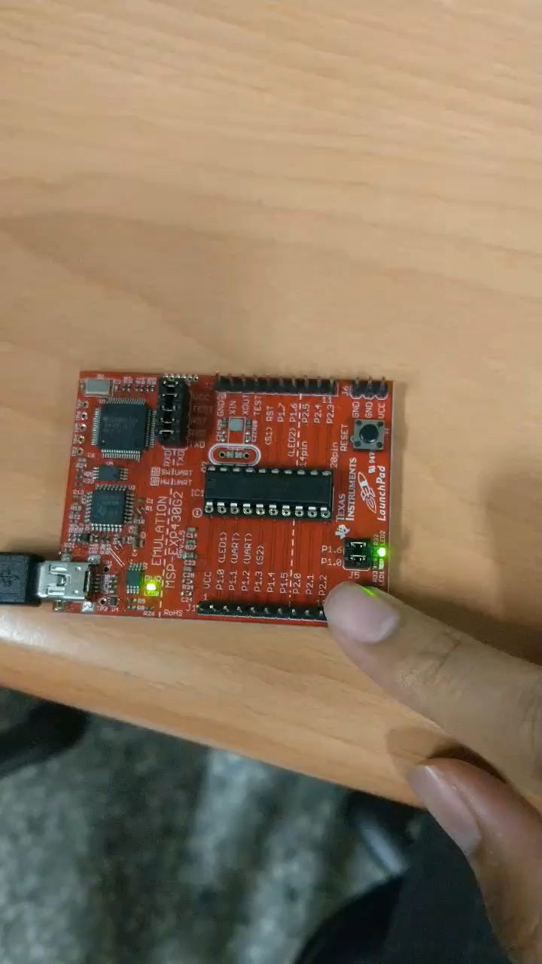
Lab 3
Basic 3: Recorder (20%)

